Slide 1
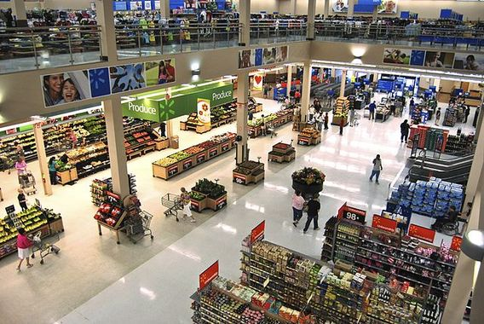
Walmart Store Expansion Recommendations
Maximizing Sales Through Strategic Store Planning & Product Placement
Notes:
Thank you for taking the time to meet today to go over our recommendations for store expansion.
My name is CB. I am a data analyst with Springboard.
First, I’d like to set the background for the business problems we have been working to address.
Walmart’s online sales have been lagging and last year accounted for a $1B loss. At the same time, in-store sales have been robust and last year accounted for 85% of total sales or $425B. This is an increase of $12B or 3% over the prior year.
Walmart’s existing stores are strategically located. About 90% of US consumers live within 10 miles of a Walmart store.
However, these stores have not been fully utilized to promote online sales. Walmart has a strategic advantage over its online competitors, since it can offer free in-store pick-up, many times on the same day.
In order to make online sales profitable and maximize in-store sales, we recommend opening new stores to reach more online customers and also convert them into in-store shoppers.
For this study, we reviewed weekly sales data from 45 current stores nationwide to determine the optimal size, design, and product placement in the stores.

Slide 2
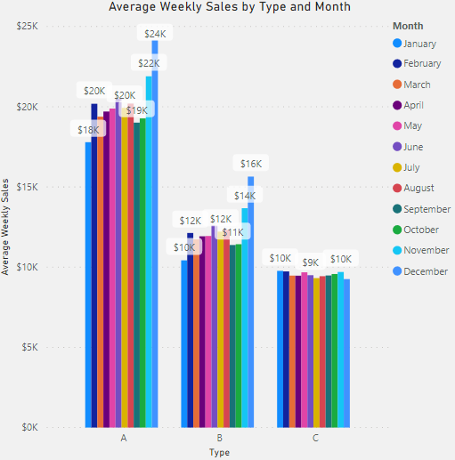
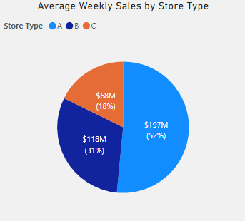
To maximize revenue, new stores should be Type A supercenter stores with a capacity of 183K-201K sq. ft. and the best selling merchandise strategically positioned, such as dry groceries, snacks/beverages, electronics, OTC medications, and health/beauty items.
Average Sales by Store Type, YTD, $m, $k
Key Insights
Average sales at Type A supercenter stores were:
50% higher than Type B stores.
98% higher than Type C stores.
Source: Walmart Recruiting - Store Sales Forecasting, accessed 11/24/2019 at https://www.kaggle.com/c/walmart-recruiting-store-sales-forecasting/data
Notes:
Our research shows that the most profitable stores are Type A supercenter stores with a sq. ft. capacity between 183K-201K.
In addition, we found that the top 10 departments by sales account for 46% of total sales. Products from these departments should be prominently displayed in the most heavily trafficked areas. Such products would include: dry groceries, snacks/beverages, electronics, OTC medications, and health/beauty items.
The pie chart on the left of this slide shows average weekly sales by the three types of stores, with Type A stores accounting for just over half of all in-store sales.
The column chart on the right shows these sales on a month-to-month basis, taking into account seasonal trends.

Slide 3
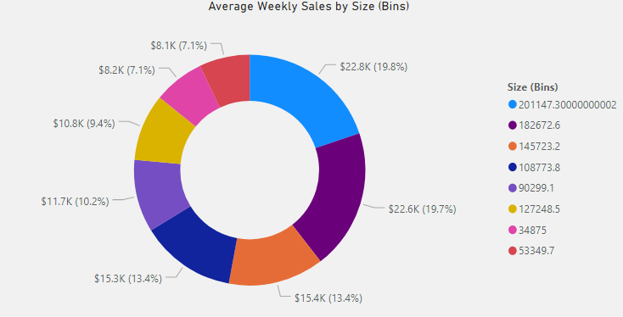
Average weekly sales at supercenter stores with a capacities of 201K sq. ft. ($22.8K) and 183K sq. ft. ($22.6K) together account for more than one third of total in-store sales.
Average Weekly Sales by Store Size, $k
Key Insights
Sales at supercenter stores with capacities of 201K and 183K sq. ft. are:
39% higher than stores with capacities of 146K and 109K sq. ft.
66% higher than stores with a capacity of 90K sq. ft.
101% higher than stores with capacities of 53K and 35K sq. ft.
Source: Walmart Recruiting - Store Sales Forecasting, accessed 11/24/2019 at https://www.kaggle.com/c/walmart-recruiting-store-sales-forecasting/data
Notes:
[Use laser pointer]
This slide shows sales by store size, with nearly 20% of sales each going to stores with sq. ft. capacities of 201K and 183K.

Slide 4
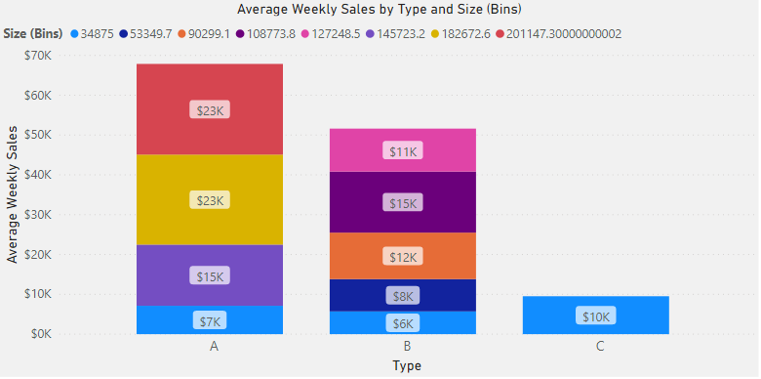
Preference should be given to opening new Type A supercenter stores with a capacity of 201K and 183K sq. ft. These stores had the highest sales average of $23K per week, representing 39.5% of total in-store sales.
Average Weekly Sales by Store Type and Size, $k
Key Insights
Second highest sales are Type A and Type B stores with a capacity of 146K sq. ft. and 109K sq. ft., respectively, with $15,000 per week.
Third is Type B stores with a capacity of 90K sq. ft. at $12,000 per week.
Source: Walmart Recruiting - Store Sales Forecasting, accessed 11/24/2019 at https://www.kaggle.com/c/walmart-recruiting-store-sales-forecasting/data
Notes:
This slide shows sales by store size categorized by store type. Again, the highest average sales were at Type A stores with sq. ft. capacities of 201K and 183K.

Slide 5
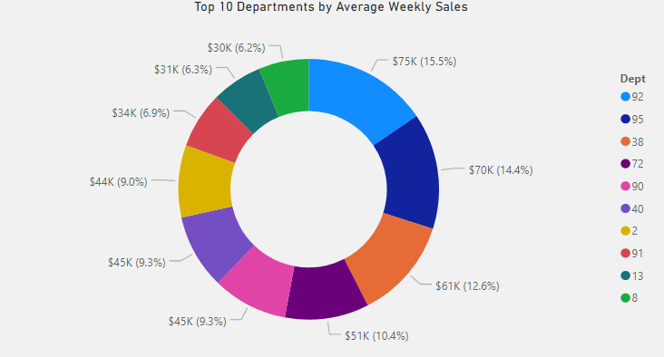
The top 10 departments by sales account for 46% of total. To maximize sales, merchandise from these departments should be positioned in heavily trafficked areas: dry groceries (92), snacks/beverages (95), electronics (72), OTC medications (40), and health/beauty (2).
Average Weekly Sales by Department, $k
Key Insights
Top 3 departments account for 20% of total sales: dry groceries (92), snacks/beverages (95), prescription pharmacy (38).
Top 5 departments account for 29% of total sales, which include electronics (72) and dairy (90).
Top 10 departments account for 46% of total sales, which include: OTC medications (40), health/beauty (2), frozen foods (91), household chemicals (13), and pet supplies (8).
Sources: Walmart Recruiting - Store Sales Forecasting, accessed 11/24/2019 at https://www.kaggle.com/c/walmart-recruiting-store-sales-forecasting/data
Walmart Department Numbers, accessed 3/21/2020 at https://www.reddit.com/r/walmart/comments/2yspx5/walmart_department_numbers/
Notes:
And finally, strategic product placement should be utilized to further maximize sales. This slide shows the top 10 departments with the highest sales. Products from these departments include…

Slide 6
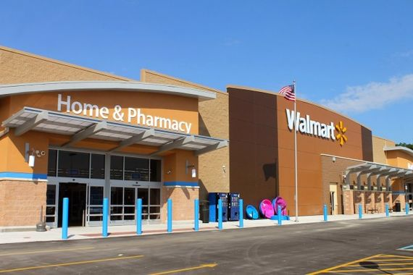
Walmart Store Expansion Recommendations
Key Takeaways:
The most profitable stores are Type A supercenter stores with a capacity between 183K-201K sq. ft.
Prominent locations in the stores should be saved for: dry groceries, snacks/beverages, electronics, OTC medications, and health/beauty items.

